Slide 1
DATAVIZ 300 Week 2: The Role of Visualizations

Slide 2
Course Topics (and Assignments)
April 12:
Week 2 – Role of Visualization in Decision Making
Data-driven decision making
Cycle of Visual Analysis
Optional Assignment #2: VizWiz
Final Project Milestone: Identify the decision you want to create a tool to visualize in your capstone project. Students who choose something they are passionate about tend to learn the most from the project.

Slide 3
Today’s Lesson: Visualization in Decision Making What makes Good Visualizations Distortion in Visualization Discussion Capstone Project Homework
Notes:
Centuries before big data, computer graphics and social media collided and gave us the datavis explosion, visualization was mostly a scientific tool for inquiry and documentation. This history gave the artform its authority as an integral part of the scientific process.
Being a product of human brains and hands, a certain degree of bias was always there, no matter how scientific the process was. The effect of these early off-white lies are still felt today, as even our most celebrated interactive maps still echo the biases of the Mercator map projection, grounding Europe and North America on the top of the world, over emphasizing their size and perceived importance over the Global South. Our contemporary practices of programmatically data driven visualization hide both the human eyes and hands that produce them behind data sets, algorithms and computer graphics, but the same biases are still there, only they’re harder to decipher.

Slide 4
Epistemic Activity intended to uncover new information
Notes:
The term ‘data’ functions as a powerful frame for discourse about how knowledge is derived and privileges certain ways of knowing over others. Through its ambiguity, the term can foster a self–perpetuating sensibility that ‘data’ is incontrovertible, something to question the meaning or the veracity of, but not the existence of.
we're not just interested in cool visualisations. We are equally interested in the politics of data - where it comes from, how it's collected, who it might endanger or empower. We are far enough along with the use of digital technologies in advocacy and activism to be critical of how much control we have over our information, and yet, the internet offers seemingly endless possibilities for creativity in activism. Moulding and shaping complex data and reams of information into a clear and compelling idea, combined with the right presentation and momentum can create strong visual advocacy. Pitch Interactive's visualisation of drone strikes in Pakistan is one such example.

Slide 5
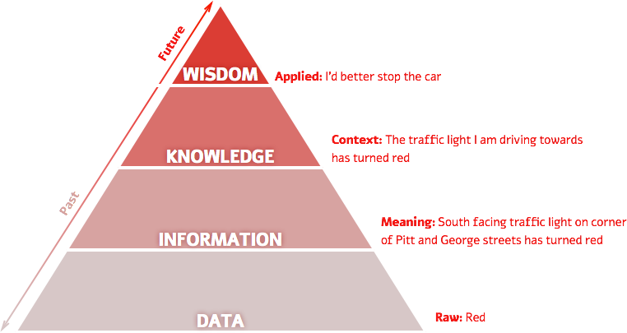
Notes:
a framework for thinking about how data gains context and meaning and becomes information. This information needs to be consumed and understood to become knowledge. And finally when knowledge influences our insights and our decision making about the future it becomes wisdom. Data visualization is one of the ways to push data up the pyramid towards wisdom in order to affect our actions and decisions. It would be wise then to look at visualizations suspiciously.

Slide 6
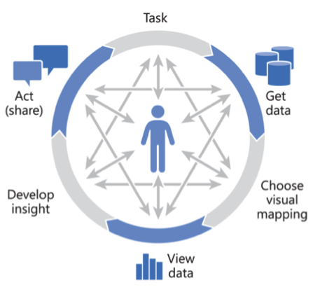
Cycle of Visual Analysis
Notes:
Cycle of Visual Analysis
In the cycle of visual analysis users start off with a pre-determined task or goal. They then go through an iterative process to get the data, choose their visual structure (chart/graph), view the data, formulate insight and then act. In reality this process is rarely as sequential as described and often involves users jumping around between different steps as new data insights (and new questions) are revealed.

Slide 7
Computer Side
Spatial
Data
Model
Working
Memory
Cognitive
Spatial
Logical
Model
Visualization of Data
Assess
Progress
Computer
Database
Long Term
Memory
Human Cognitive Side
Notes:
Visualization Model

Slide 8

Notes:
What data do you have?

Slide 9
Notes:
People often form a picture in their head of what a visualization should ook like or find an example they want to mimic. When its time to visualize they realize the either need more data or their data doesn’t work with what they want to create.
Biggest mistake is imagining the visualization before understanding the data.

Slide 10

Notes:
http://blog.visual.ly/creating-infographic-start-finish/
Second biggest mistake: Find the data to tell the story you want.

Slide 11
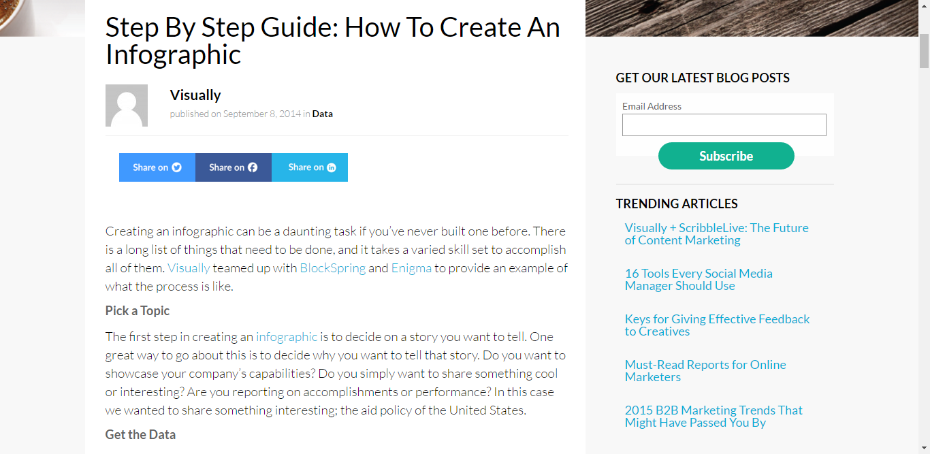

Slide 12


Slide 13
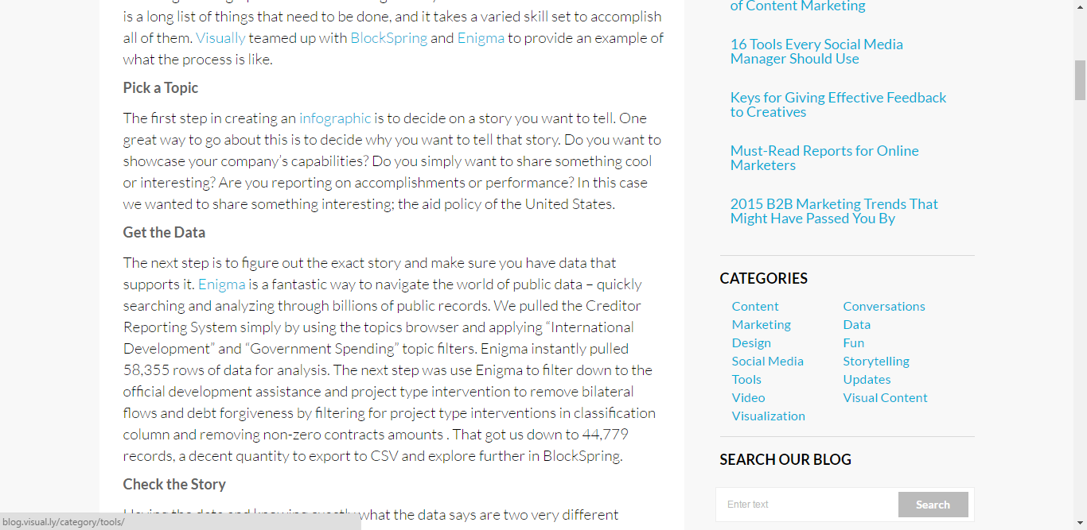

Slide 14


Slide 15
Good answers lead to more good questions.
Notes:
Good answers lead to more good questions. A good visualization can really help ignite that process.

Slide 16
Things To Consider
4
Notes:
Visualization is what happens when you make the jump from raw data to bar graphs, line charts, and dot plots. It is the process that takes you from… to a bar graph over time.
It’s easy to think that this process is instant because software enables you to plug data in and you get something back instantly. But there are many steps and choices that happen in between. What shapes should you choose to encode your data? What color is most appropriate for the purpose and message? You can let the computer choose everything for you (Tableau’s R&D team has helped to enable good default choices).
In many ways, visualization is like cooking. You are the chef and the datasets, geometry, and color are your ingredients. A skilled chef, who knows the process of how to prepare and combine ingredients and plat the cooked food, is likely to prepare a delicious meal. A less skilled cook, who heads to the local freezer section to see what microwave dinners look good, might nuke a less savory meal. Of course, some microwave dinners taste good, but there are a lot that taste bad.

Slide 17
Things To Consider
4
What do you want to know about your data?
What data do you have?
What visualization methods should you use?
What do you see and does it make sense?
Notes:
The answer to each question depends on the answers that come before it and its common to jump back and forth between questions. Its an iterative process.
If you data set is only a handful of observations, this limits what you can find in your data and what visualization methods are useful, and you won’t see much.
On the other hand if you have a lot of data, what you see when you visualize one aspect of it can lead to a curiosity about other dimensions, which in turn leads to different graphics. This is the fun part.

Slide 18
Don’t Know Yet
START
HERE
None or next to nothing
What do you want to know about your data?
What data do you have?
Best data
ever
(Specific
Question)
New
Questions
Arise
What visualization methods should you use?
Find related data
What do you see and does it make sense?
Bar Chart
Line Plot
Scatterplot
Explore Different Dimensions

Slide 19
What Data do you have?
% of Time
Duration
Learning
Jedi
Gathering Data
Visualization Data
Notes:
Don’t be surprised if most of your time is spent gathering data and little time is spent visualizing it. We are going to go into much more detail next week about data.
Remember, the mistake most people make is about building the visualization in their mind first, before gathering and looking for data. It should be the other way around, data first and visualization second.
Often, getting the data tha tyou need is the hardest an dmost time confuming part of the visualization process. In school, data is handed to you formatted the way you need so that you can easily load it into the software of your choice, but this is hardly every the case in practice. You might need to scrape data from a website, access an Pai, or derive values from esixting data.
For example, you might have a list of addresses, but to map them, you need longitude and latitude coordinates.

Slide 20
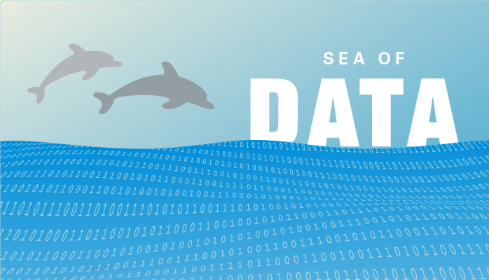
What do you want to know about your data?
Notes:
Imagine you have some data to explore. Where do you begin? The answer is easy if you only have one data point. You can just read the value, and most of your findings, if any, will come from outside information and additional data. On the other hand, when you have a dataset with thousands or millions of observations (think spreadsheet), it can be challenging and often intimidating to figure out what to look for first.
This is where the phrase “drowning in data” comes in. It can be akin to the blank page in writing. Debilitating.
You stare at a bunc of numbers on your computer screen and the values start to blur together th longer you stare.
To avoid drowing you need to learn how to swim. We are going to get into that much more next week, but for now. Think about it as starting in the shallow end, and work your way towards the deep end.
To start, ask yourself what you want to know about the data. You answer doesn’t need to be complex or profound. Just makes it less vague then “I want to know what the data looks like.” The more specific you are the more direction you get. Maybe you want to know the best sports team, or worse school, or richest country. . Do you explore ranking and if you have multiple variables you decide what makes something good or bad. If you have time series data you may want to know if a situation has gotten better or worse.
When you ask questions about your data, you give yourself a place to start and if you’re luck as you investigate you come up with more question and you dig into those. Coming up with and answering potential questions helps build focus and purpose.

Slide 21
Possible Questions What ___ is the best and worse? Max/Min How has ____ changed over time? Temporal Patterns What _____ stands out from the rest? Outliers What makes ____ different from ____? Clustering How are ___ and ____ related to each other? Correlation What’s the breakdown for _____? Distributions
Notes:
What would be a good graph to go with each one?

Slide 22
Possible Questions What ___ is the best and worse? Bar Chart How has ____ changed over time? Line Graph What _____ stands out from the rest? Scatter Plot What makes ____ different from ____? Scatter w/ Shapes How are ___ and ____ related to each other? Scatter w/ Trend What’s the breakdown for _____? Tree maps
Notes:
What would be a good graph to go with each one?

Slide 23
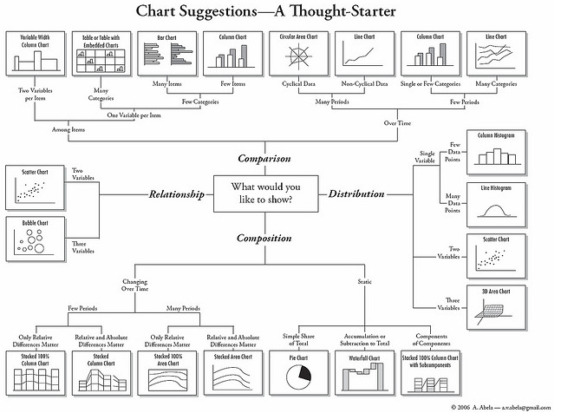
What visualization method should you use?
Notes:
We are going to get deeper into these later. For now as you explore data, start simply. Use bar graphs, line charts, and to allow you to quickly get a sense of the data.

Slide 24
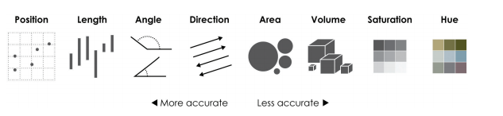
What do you see and does it make sense?
Notes:
After you visualize your data, there are certain things to look for. Increasing, decreasing, outliers, or some mix. Take note of how much change there is and how prominent the patterns are. How does the difference compare to the randomness in the data?
Observations stand out because of human or mechanical error, because of the uncertainty in estimated values, or because there was as person or thing that stood out from the rest. When you find something interesting, ask yourself” Does it make sense? Why does it make sense? This step is massively important.
The tendency is to automatically think the data as fact because numbers can’t possibly waiver (we will come back to this latter in the lesson_. But again, ther’s uncertainty attached to the data beacsue each data point is a snapshot of what happened during a moment in time. You infer everything else.

Slide 25
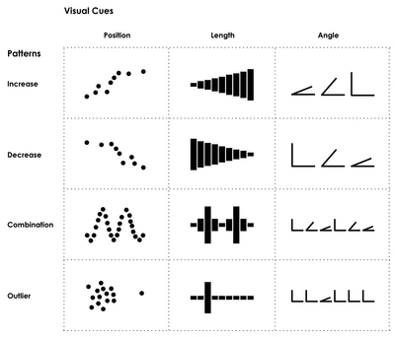
Notes:
Let’s review some examples. I left some of theses intentionally blank because I wanted to you take a moment to fill them in.

Slide 26

Summarize… 1. Start from the Question 2. Find a data source 3. Explore to understand the data 4. Identify the story 5. Think about how best to tell it 6. Build it. 7. Iterate for clarity.

Slide 27
Today’s Lesson: Visualization in Decision Making What makes Good Visualizations Distortion in Visualization Discussion Capstone Project Homework

Slide 28
content / structure / presentation

Slide 29
4 Elements of a Viz: Visual Cues Coordinate Systems Scale Context Data is the driving force behind them.
Notes:
From Nathan Yao.
In its most basic form, visualization is simply mapping data to geometry and color. It works because your brain is hard wired to find patterns, and you can switch back and forth between the visuals and the numbers it represents. This is the most important bit. You must make sure the essence of the data isn’t lost in the back and forth between the visual and the value it represents because if you can’t map it back to the data it is just a bunch of shapes.
You must choose the right visual que, which changes by purpose, and you must use it correctly, which depends on how you perceive the varied shapes, sizes, and sahdes.

Slide 30
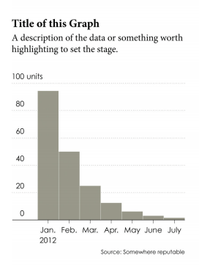

Slide 31
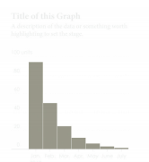
Visual Cues
Notes:
Visualization involves encoding data with shapes, colors, and sizes. Which cues you choose depends on your data and your goals.

Slide 33
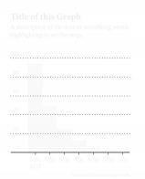
Coordinate System
Notes:
You map data differently with a scatterplot that you do with a pie chart. It’s x- and y- coordinates in one and angles with the other. It’s Cartesian versus polar.

Slide 34
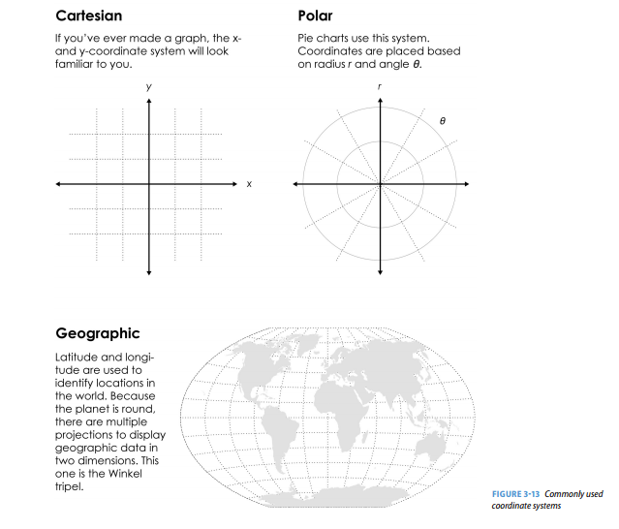
Notes:
There are a variety of them, from cylindrical to spherical, but these three will cover most of your bases.

Slide 35
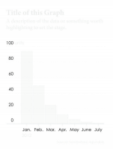
Scale
Notes:
Increments that make sense can increase readability, as well as shift focus.

Slide 36
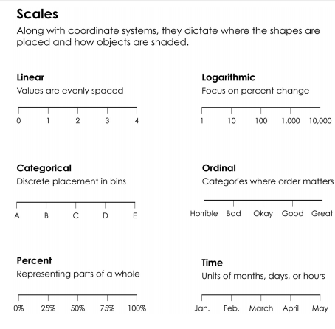

Slide 37
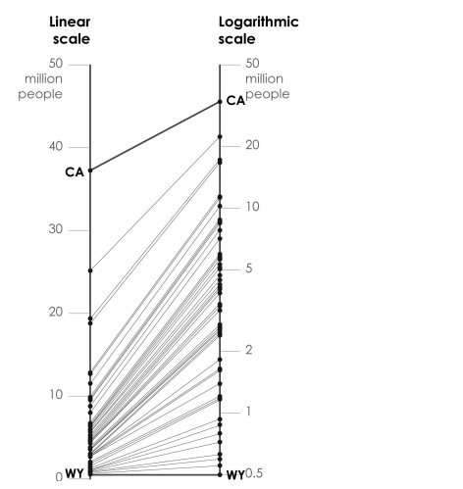

Slide 38
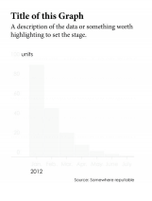
Context
Notes:
Context if you audience is unfamiliar with the data, it’s your job to clarify what values represent and explain how people should read your visualization.
Context (information that lends to better understanding the who, what, when, where, and why of your data) can make the data clearer for readers and point them in the right direction. At the least, it can remind you what a graph is about when you come back to it a few months later.
A descriptive title is a small but easy thing you can create to set up readers for what they’re about to look at. Imagine you produce a time series plot for gas prices that shows an upward trend. You could just title it “Gas Prices” and that would be a fair title. That’s what it is, but you could also title it “Rising Gas Prices,” which says what data is used and what is shown. You could also include lead-in text underneath the title that describes fluctuations or by how much gas prices rose.

Slide 39
BREAK
Notes:
After we get back from break, we will be diving into some deeper subject manner. I consciously choose topics that are heated and emotionally charged. I did this to show the importance of how our methodology impacts our beliefs and our beliefs impact our interpretations.
If the topics of abortion and rape are too much for you, feel free to finish the class via the recording.

Slide 40
Today’s Lesson: Visualization in Decision Making What makes Good Visualizations Distortion in Visualization Discussion Capstone Project Homework

Slide 41
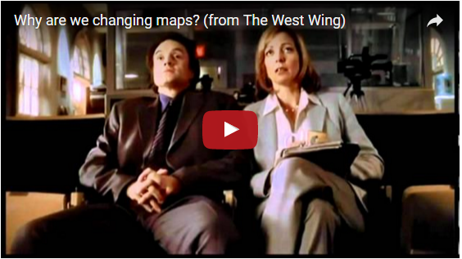
https://youtu.be/eLqC3FNNOaI

Slide 42
Beliefs
Beliefs
Results
Actions
Notes:
From Management Trainings such as The Oz Principals… Kirsi Hall.

Slide 43
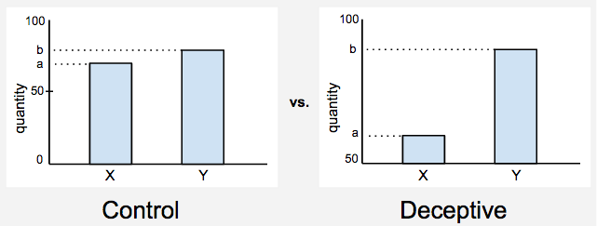
Truncated
Notes:
For the experiment we selected a series of well-known graphical distortion techniques and developed a study on Amazon Mechanical Turk with hundreds of participants to test the deception effect.
When the bars do not start from zero (right) the difference looks much bigger.

Slide 44
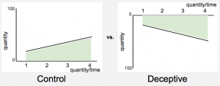
Inverted
Notes:
When the axis is inverted (right) the values grow towards the bottom and thus mislead the reader.

Slide 45
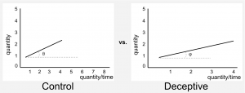
Aspect Ratio
Notes:
The ratio can be manipulated to give the impression a quantity grows much faster/slower than it does.

Slide 46
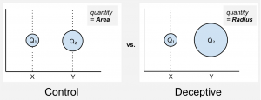
Area
Notes:
When a quantity is mapped to the radius, the perceived quantity is the area of the bubble which grows quadratically.

Slide 47
The Experiment
Notes:
We present half of the participants with a deceptive version of the chart and half with the not deceptive one. Then, we ask the same question to both and measure the difference between the two. Let me give you an example.
We show bar charts similar to those shown above and say that they represent the percentage of population with access to drinking water in Willowtown and Silvatown (yes we use fake names, see why in the paper). One version has a truncated axis, the other does not. Then we ask: “How much better are the drinking water conditions in Willowtown as compared to Silvatown?“.
The participants do not have to provide a precise number, rather they have to provide a gross estimation of the effect using a 5-item Likert scale, ranging from “slightly better” to “substantially better“. We do the same with other charts and data, using slightly different questions and then compare for each case how the two versions compare. Here are the results.

Slide 48
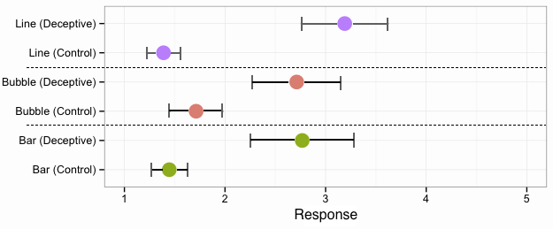
Notes:
This is a comparison of the average response with confidence intervals. The average is the dot, the confidence interval is the hinges you see around the dot (confidence intervals show plausible values, that is where the dot may fall). Each color represents one chart type: line, bubble, bars (we have inverted axis also in the paper but it is not shown here).
For each chart the control, that is the chart with not deceptive effect, should lead to a smaller estimate in the response.
When I ask you “How much better are the drinking water conditions in Willowtown as compared to Silvatown?” the control chart should show that the difference is not that big. But when I show you the same data with a truncated axis, the difference between the bars looks bigger and this should lead to a much bigger estimate. This is exactly what you can see in the chart above. For each condition the deceptive version always leads to bigger estimates. You can also see that line charts and bar charts seem to have a more dramatic effect than bubbles.
The paper shows other aspects of the study. For instance, we tried to see whether this effect ismodulated by individual differences like gender, age, education level, etc., but we failed to find these differences (this of course does not mean they do not exist).

Slide 49
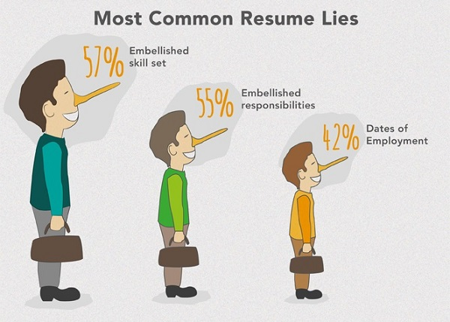
Notes:
Let’s set up some rules.
We don’t spread visual lies by presenting false data. That would be lying. We lie by misrepresenting the data to tell the very specific story we’re interested in telling. If this is making you slightly uncomfortable, that’s a good thing, it should. If you’re concerned about adopting this new and scary habit, well, don’t worry, it’s not new. Just open your CV to be reminded you’ve lied with truthful data before. This time however, it will be explicit and visual.
To deconstruct possible lies I suggest we use the content / structure / presentation model as three lenses through which we can analyse a graphic. Each of these layers is susceptible to manipulation. When it comes to the content of the message, even before it is visualized, the initial data could be truthful, but the way it was gathered could be manipulated. For example:

Slide 50
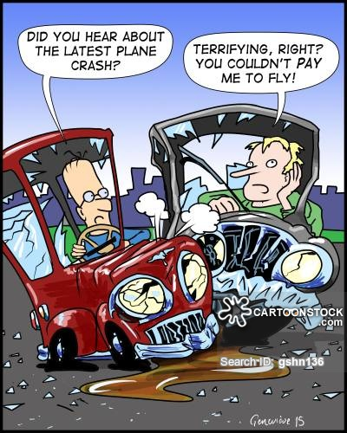
Framing….
Notes:
Should we legalize the killing of babies?
I would hope most of you would say: No. But what if I ask you:
Should women have the right to their own bodies?
This time, I would like to think that most of you would say: Yes. But then again, what if I frame it like this:
Should abortions be legal?
If framed as a survey question, only one of these three questions truthfully represents the so-called pro-life / pro-choice debate without choosing sides in advance.

Slide 51
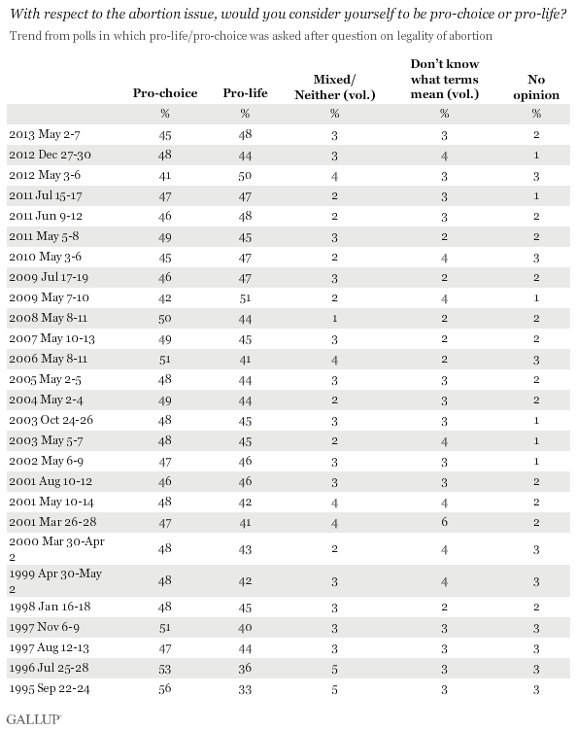
Notes:
Let’s investigate lies in the structure layer through an actual poll. Gallup has been surveying this issue with the American public for almost 20 years now, often multiple times a year. They frame the question in a slightly more political way:
With respect to the abortion issue, would you consider yourself to be pro-choice or pro-life?
And this is the data they received:

Slide 52
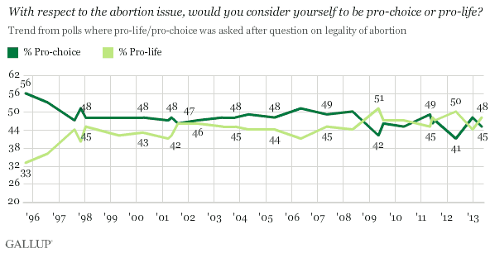
Notes:
As a table it is really hard to quickly identify trends and changes in the data, but as a graph we can start climbing up the DIKW pyramid:

Slide 53
Notes:
a framework for thinking about how data gains context and meaning and becomes information. This information needs to be consumed and understood to become knowledge. And finally when knowledge influences our insights and our decision making about the future it becomes wisdom. Data visualization is one of the ways to push data up the pyramid towards wisdom in order to affect our actions and decisions. It would be wise then to look at visualizations suspiciously.

Slide 54
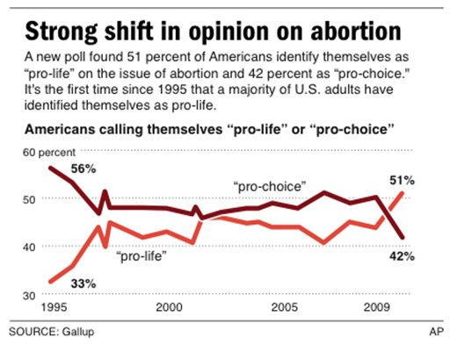
Notes:
Gallup’s graph makes sure to plot every data entry and it marks the numbers along the lines at evenly selected intervals.
Back in 2009 when the AP wanted to use the data to tell a good story, all they needed was to skew the graph’s proportions a bit, change the starting point of the vertical axis and switch to thicker, less nuanced lines that based on the very same data emphasizes a clear trend in the graph. And a clear shift in opinion in such a huge ideological debate makes for a much more interesting story.

Slide 55
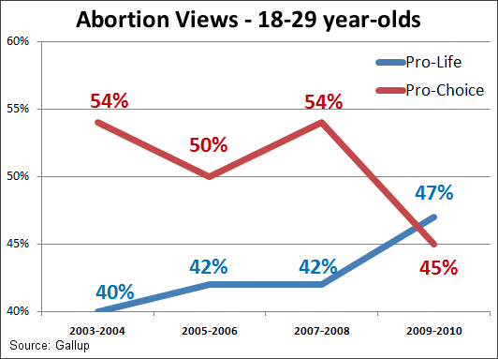
Notes:
Earlier in 2009 when pro-life site LiveAction.org wanted to graph the same data to preach to the choire and say “we’re winning!”, it chose a much more selective reading from the data and plotted this graph:
This time, no need to admit the public opinion was ever at the 1990’s low pro-life mark, so starting from 2003-2004 is fine. Focusing on a shoter time frame to tell a story of consistent increase helps too, as does the choice of 18-29 years old age brackets. There’s nothing about the data that isn’t true, but it is very selective.

Slide 56
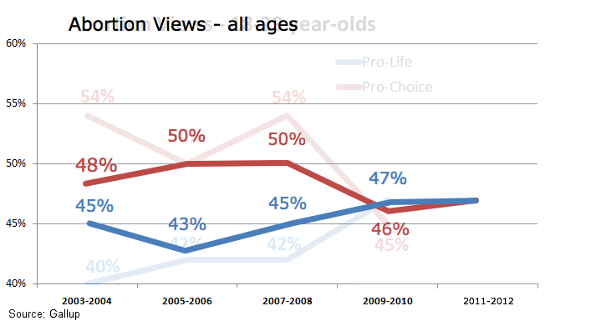
Notes:
If we use the same data as the first graph, published by Gallup, and extend it for two more years, the graph might look like this:
The image presents a much less definitive trend now. It still misrepresents the data, but less selectively. These selective readings are what we can consider as manipulations in the choice of structure.

Slide 57
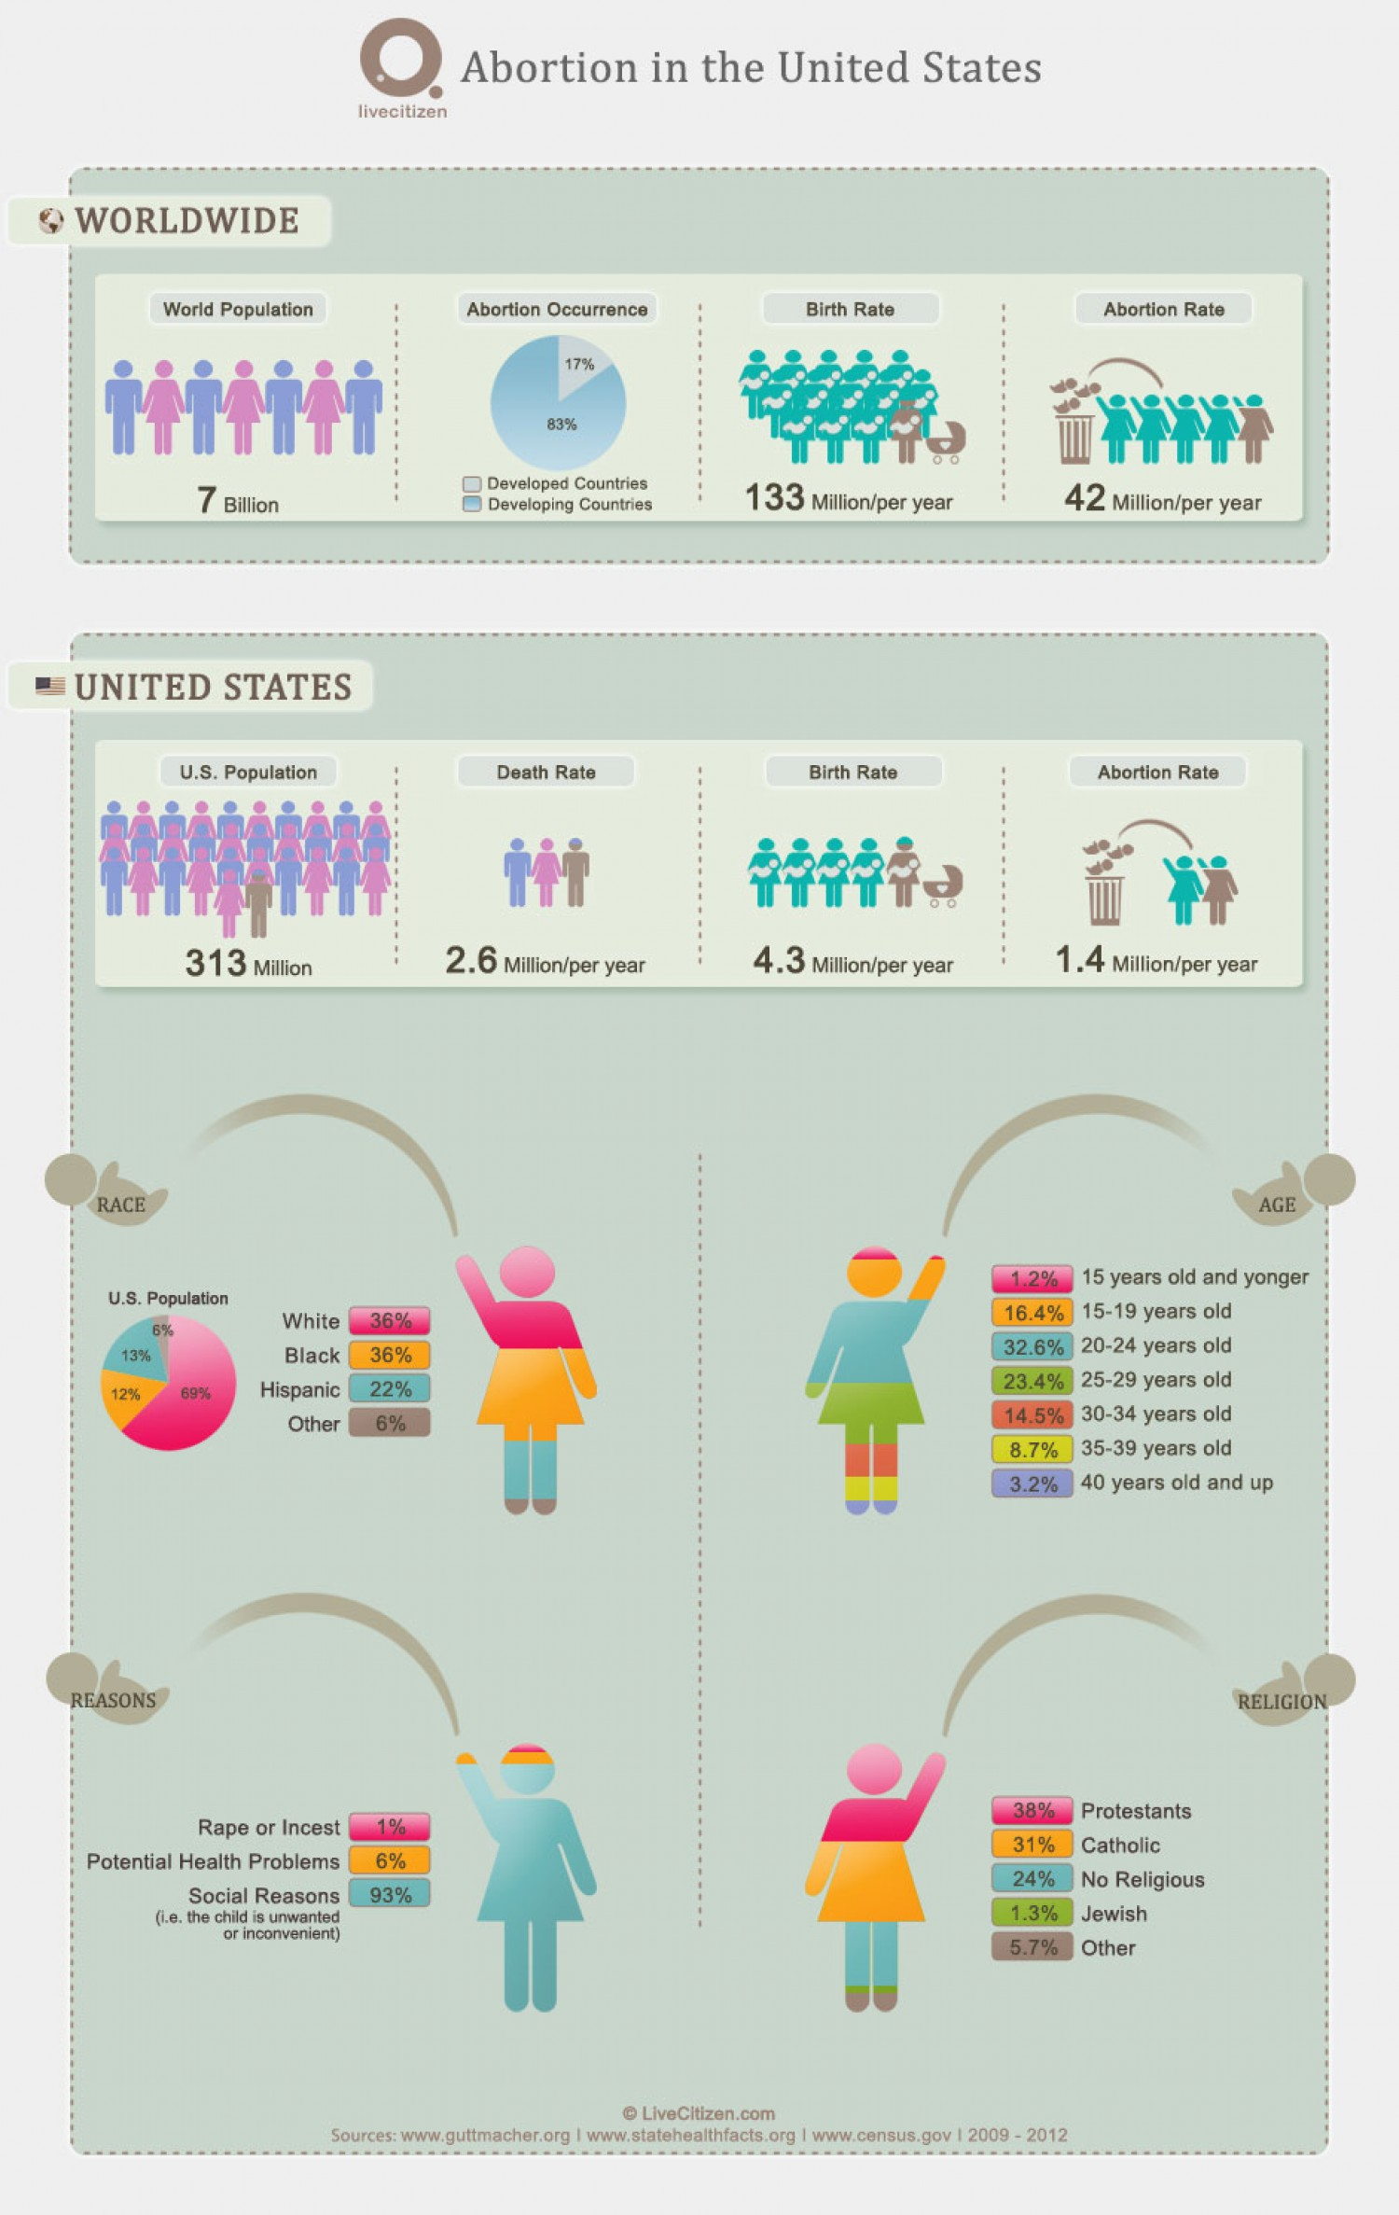
Notes:
When we get to the presentation layer, that’s when our options for manipulation really widen. We get to use contrast and color, size and composition, shape and typography, movement and interaction… every choice is an opportunity to suggest a specific reading of the data, an opportunity to lie while seemingly telling the truth.
Let’s continue with the theme of the abortion debate and examine this infographic from the pro-life site LiveCitizen.com:

Slide 58
Notes:
This infographic is packed with visual tricks. First, there’s the sheer volume of stats. Before you can even consider one statistic you are encouraged to examine the next. This helps to keep your guard down and ties the order of the stats into a coherent and directed narrative. Second, the use of generic icons to represent male and female elegantly expands to represent abortion as a mashup of a female icon, a fetus and a trash can. Third, the scale change between the worldwide abortion stats (42 million = 5 baby throwing mommies) and the US stats (1.4 million = 2 baby throwing mommies) subtly misrepresents the US as responsible for ⅖ of the world’s abortions. A more careful reading of the numbers would correct this visual misrepresentation, but who has the time to read carefully when there are four huge colorful baby throwing mommies coming up next?

Slide 59
Notes:
This part of the visualization goes further to skillfully use more and more manipulation techniques. The “Race mommie” shows that even though black mommies are only 12% of the US population they throw as many babies as the 69% white majority. No word about any socio-economic correlation between the white and black communities. If we are interested in the reasons behind the baby throwing, we can look at the “Reasons mommie”, here 93% of the reasons are dubbed “social”, and since that might be seen as a bit abstract, the label explains: “i.e. the child is unwanted or inconvenient”. This short and snappy description is summing up the slightly longer and boring results from the source behind the numbers:
“Worldwide, the most commonly reported reason women cite for having an abortion is to postpone or stop childbearing. The second most common reason—socioeconomic concerns—includes disruption of education or employment; lack of support from the father; desire to provide schooling for existing children; and poverty, unemployment or inability to afford additional children…”

Slide 60
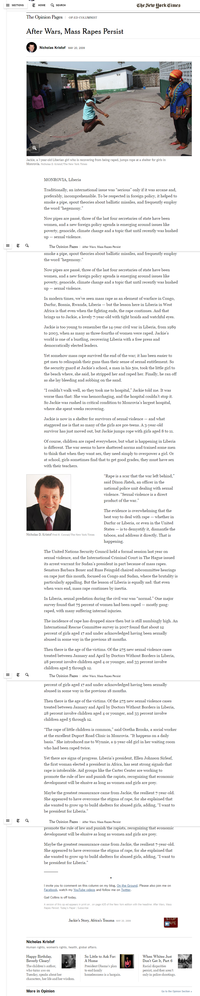
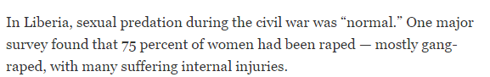
Notes:
Behind the Numbers
In 2009, the columnist Nick Kristof wrote a story in the New York Times about how 75% of Liberian women had been raped as a result of the civil conflict from 1989-1996. A political scientist at Drexel University in the United States, Amelia Hoover-Green, has spent the last few years absorbed by the fact that counting violence on a large scale is inevitably flawed, and tries to find ways to get around these flaws. Describing this incident in a personal interview in December 2013, Hoover-Green says that when she and a collaborator, Dara Kay Cohen, read Kristoff's story they were alarmed at the figure he quoted; they didn't know where it came from and how accurate it was so they set out to find out more about this statistic.
Hoover-Green and Cohen were able to show that the source of this figure, a study by the World Health Organisation, was flawed for the following reasons. The figure - 75% - was extrapolated from a study done in three particular counties in Liberia. There was no mention of surveys based on samples from the whole population, so the figure showed as inflated. Also, survivors' accounts given to the Liberian Truth & Reconciliation Commission put the figure at a considerably lower amount:10-20%. According to Hoover-Green, bad data leads to poor decision-making, the misallocation of resources and the increased likelihood of not being the sort of advocates affected women need. She says of the Liberia case that:
“Kristof, eager to show that rape was an emergency in Liberia, had mangled the evidence, generalizing from a study of sexual assault survivors to all Liberian women. To be clear, rape was absolutely an emergency in Liberia. Depending on which survey you read, 20 to 40 percent of Liberian women report suffering some form of sexualized violence. The problem, beyond simple inaccuracy, is that Kristof's false generalization defined sexualized violence as “the problem” for Liberian women. Like many of our false generalizations about rape, that’s conveniently simple—but in painting women as rape victims, it erases bigger and more complicated stories about war, violence, displacement, and survival.”

Slide 61

Tia
Palermo
Professor,
Stonybrook College
Notes:
Where is the data coming from?
The social production of data refers to how a research or data collection exercise is structured and carried out, and what happens to the data afterward. Annette Markham writes that data is not a thing or even a set of things, but is, rather, a “powerful frame for discourse about knowledge — both where it comes from and how it is derived; privileges certain ways of knowing over others.”
In this case, some may ask, what is there to know? Rape is rape; does the origin-story of the data really matter when the crimes are so horrific? Isn't it is bad enough to know that even one woman's rape went unpunished? Whilst this is true, specific numbers allow for criminals to be tried in courts of law for their crimes, and for legal or other services for victims, prevention, law-enforcement, awareness-raising to be developed in response to the scale of the problem. Accurate data also reveals the actual scale of and patterns in the violence.
Not having close approximates of actual figures – either under- or over-reported – can be problematic. Tia Palermo says that estimates
“may belittle the extent of the problem and fail to induce the international community to act. Alternatively if estimates ...are exaggerated, future scenarios might seem less severe in comparison...international organizations and governments may be less inclined to act or to [will] allocate resources inefficiently.”
Accurate or near-accurate numbers are important. As important is how they're eventually used in campaigns or policy advocacy. The choices made in what to collect, how to collect it and from whom or where determine how we can claim to know the scale or actual extent of a particular issue. The data-based claims made about an issue like sexual violence can sometimes significantly shape the debates around it, which is why knowing how and where the numbers come from is important; especially when there are different numbers emerging on the same issue.

Slide 62
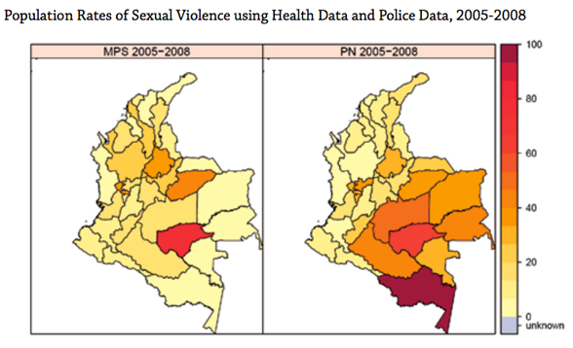
Notes:
This graphic demonstrates the very different geographic patterns of rape reporting by two Colombian sources, both ostensibly complete: the Health Ministry (on the left) and the police (on the right). (Graphic from Francoise Roth, Tamy Guberek and Amelia Hoover Green, "Using Quantitative Data to Assess Conflict-Related Sexual Violence in Colombia: Challenges and Opportunities." Corporación Punto de Vista and the Human Rights Data Analysis Group, 2011)
Survey data are less biased than self-reports, but they’re hardly airtight. A study published in 2009 found that changes in survey question wording led to a tenfold difference in reports of past-year rape victimization (as opposed to lifetime victimization), from about two per 1,000 to about 20 per 1,000 among U.S. college women. There are about 7 million full-time female college students in this country, so that’s the difference between 14,000 rapes and 140,000. (Police data, by contrast, showed 459 forcible rape cases at U.S. universities in 2009, a number I got by downloading the FBI’s Uniform Crime Report data and summing across all universities.)
Of course, the problem goes beyond not knowing how many reports there are and aren’t. We don't know which victims are underrepresented—and we often don't think to ask, Whose story is missing here?—which means we're prone to false generalizations.

Slide 63
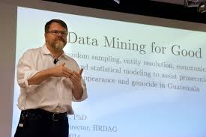
Patrick Ball Human Rights Data Analysis Group
Geetanjali Misra
Notes:
Sampling death in Syria
In some situations, like conflict, it is almost impossible to estimate how many people have actually been affected, and assessments of the death toll in Syria is a good example of this. Reports estimate anywhere from 50,000-100,000 deaths from the conflict that started in 2011. To appreciate the mathematical challenges in accurately counting how many people have died as a result of the atrocities requires a metaphor:
“Imagine that you have two dark rooms, and you want to know how big the rooms are. You can't go into the rooms and measure. They're dark, and you can't see inside them, but what you do have is a bunch of little rubber balls. Throw the balls in one room, and you hear frequent hollow pinging sounds as they bump into each other. Throw them into the next room, and the sound is less frequent. Even though you can't see inside of either room, you can intuit that the latter room is the larger of the two.
This is a quote by Patrick Ball, the human rights data scientist who works with the Human Rights Data Analysis Group in California. One of the reasons why Ball's numbers and methods are so well respected is because he is acutely aware of the 'social production of data'. In January 2013, Ball collaborated on Benetech's preliminary assessment of the death toll in Syria. He says about this:
“We can solve issues of data capture and data management; our bigger problem is sampling the population we need to study in understanding how mass violence works. You cannot claim to see a pattern in the data if your sample is not representative.”
Sampling, or the rationale for choosing a part of a particular population to study, on the basis of which claims will be made about the whole population, is one of the first and most fundamental issues that data collection initiatives have to contend with. Getting a representative sample, however, is often near impossible without significant resources; as a result, a lot of research can be challenged on the basis that it is not possible to effectively infer things about the entire population from the research sample.
In the case of sexual violence, things get more complicated because statistics about sexual violence in conflict is “rare and elusive” as Hoover-Green puts it, meaning that it is not evenly distributed in a population, so a randomly selected sample is unlikely to reflect actual patterns. Moreover, unlike the verifiable, objective reality of death, sexual violence isn't defined in one way only and there is always the problem of underreporting.
Hoover-Green, Ball's one-time colleague, discovered that “basic questions regarding the nature, magnitude, pattern, variation, perpetrators and effects of wartime sexual violence cannot yet be answered with scientific rigor. Stakeholders must also grapple with the fact that no single dataset, no matter how large, can accurately assess conflict-related sexual violence on a population level.”
Hoover-Green has also published a set of guidelines for the measurement of sexual violence in conflict; these guidelines offer tips on how to make inferences based on incomplete evidence and takes examples of messy qualitative reports and shows how to work through verifying the information in them. These guidelines were developed based on her work in Colombia a case in point about how statistics on sexual violence in conflict are inadequate, and that reliable, national-level statistics are near-impossible.

Slide 64

Geetanjali Misra
Founder of Crea
Notes:
Does it matter?
In an interview about her organisation's study of violence against marginalised women in South Asia, Geetanjali Misra, the founder-director of Crea, a women's rights organisation in Delhi, says that data is “part-truth, part-lie”. What Misra refers to is the [un]certainty with which we believe that data must reveal truth. What if this is a false truth or if the hopes we have invested in data to tackle social issues with dark histories of power are false? If claims cannot be made with any rigour, as Amelia Hoover-Green says then how does data work in advocacy?
Hoover Green is interested in what this means for the long-term health of human rights organisations working with data for advocacy. Inaccurate claims about sexual violence heighten the tension between “advocacy organizations' needs for short-term drama and long-term credibility.” If your data is flawed and if as an organization you continue to use flawed data, what does this mean for how credible your work is? The perception of human rights activists using any data they can get to make their case persists, and this doesn't do anything for the credibility of the people human rights activists are trying to represent.
The challenge this presents to advocacy groups is to know what they're using the data for and who they are speaking to. To a legal team prosecuting rapists and militia leaders for tens of thousands of rape in conflict at the International Criminal Court absolutely need accurate or near-accurate data. To a policymaker, similarly, data that isn't rigorously collected or representative can lead to decision-making that may not have a solid rationale. To the enthusiastic and sincere hackers for change, data may serve a different purpose: to bring diverse technical and advocacy communities together around the issue by playing around with data-sets. According to Ball, reliable, or near-reliable, statistics come from dataas interpreted through a model. Merely 'counting cases' as data collection does not make for a robust model.
'Pulling out the storylines in data' may be a familiar phrase to anyone working in data journalism or capacity building on data for advocacy. The social production of data is in itself a storyline in and about data worth telling: it may reveal more than the data does.

Slide 65

Annette
Markham
Professor, Umeå
University, Sweden
Notes:
Annette Markham says that the most important, in her opinion, is that researchers of sexualized violence use multiple research methods, complementing numbers with narratives and vice versa. In fact, our numbers should have narratives. Having a clear sense of the origins of our data—knowing the survey questions, thinking through the sampling strategy, considering access to reporting mechanisms, looking for holes in the net—can protect us from the worst of our interpretive excesses.
Why does this matter? Obviously, getting it right is key to prevention and accountability efforts. Ultimately, the goal is less rape, not just more awareness, and the way we approach evidence affects the policies we put in place.
On a more fundamental level, though, she is convinced that getting it right is a respect issue. Looking at rape data and asking the wrong questions (or overgeneralizing, or ignoring complexity) is akin to looking at a rape survivor and doing the same. She wants to be sure we do better for the women and men who have already suffered enough.

Slide 66

Making an evidence presentation is a moral act as well as an intellectual activity. To maintain standards of quality, relevance, and integrity for evidence, consumers of presentations should insist that presenters be held intellectually and ethically responsible for what they show and tell. Thus consuming a presentation is also an intellectual and a moral activity.
—Beautiful Evidence, Edward Tufte
Notes:
In the introduction to his book, Edward Tufte, the leading scholar of information visualization talks of the moral grounds to which information visualization should strive. He talks of “universal principles of analytical thinking” as the foundations of information design work and opposes the role of subjective contexts like local customs, fashion and technology in their making. Tufte’s decision to title his book “Beautiful Evidence”, seems like an attempt to define the ideal presentation of data: to "delight both by the wonder of the spectacle and the accuracy of expression." Tufte does not deny the dangers of manipulative imaging, and devotes two chapters to warn us against these “unbeautiful anti-evidence”, but I would argue that a lie can still be beautiful and that even honest image making should not be regarded as evidence.
I am not sure we should expect the design of “Beautiful Evidence”, as much as we should learn to regard these visual expressions as a form of speech and therefore as “beautiful arguments”. In these beautiful arguments the delight, the wonder and the spectacle might actually stand in the way of accurate representation of reality. While Tufte acknowledges evidence presentation is a form of discourse, he practically advocates we limit the discourse and keep our images a-political. However too-often this seemingly scientific, fact-driven, a-political visual makes us drop our guard and de-politicizes these seductive beautiful arguments.
Our eyes are trained to process the visual environment as evidence, and to process the products of language as arguments. Therefore, whether beautiful or ugly, visual lies masquerade as evidence and slip under our radar. We, in return, readjust our worldview to accommodate these visual lies as we do when we witness evidence. As long as we do this, there will be those who will continue to tell these visual-lies, convincing us, and often themselves, that evidence will make itself evident and that subjective culture and political biases won’t creep in.
I am not advocating an iconoclastic anti-visual approach. I, like Tufte and many others, believe visual language should be an integral part of analytic thinking, deliberation and communication. But I suggest we do not strive for seamless visual communication. The straight line from data and information through visuals to knowledge and wisdom doesn’t exist and we should not pretend that it does. Rather than seamless design, data visualization should embrace the seamful approach that deliberately exposes the seams of the fallible human process of image making. One that acknowledges the image as an argument, as speech, as a part of visual language, to be debated with, questioned, talked back to or even visualized back to.

Slide 67
https://tc14.tableau.com/schedule/content/910
Notes:
https://tc14.tableau.com/schedule/content/910 @ 27:45

Slide 68
Today’s Lesson: Visualization in Decision Making What makes Good Visualizations Distortion in Visualization Discussion Capstone Project Homework

Slide 69
“Use data visualization to generate ideas not truth. Data visualization is a creativity tool.” - Enrico Bertini Do you agree or disagree? Why?
Discussion/Reflection
?
Notes:
Enrico Bertini of http://fellinlovewithdata.com/
This comment really hits a nerve on me as I have been thinking about this issue quite a lot lately. I must confess I am no longer satisfied with the word “visualization”. And I am even less satisfied by all the other paraphernalia people like to use: data visualization, interactive visualization, information visualization, visual analytics, infographics, etc.
The reason is that I think all these words do not describe well the work I and many other people do. While visualization seems to be appropriate when the main purpose is data presentation, I don’t think it captures the value of visualization when it is used as a data sensemaking tool.
When used for this purpose interaction is crucial. Analysis looks more like a continuous loop between these steps:
specify to the computer what you want to see and how (the specific visual representation)
detect patterns, interpret the results and generate questions
ask the computer to change the data and/or the visualization to accommodate the new question(s)
assess the results … repeat …
Analytical discourse is a term I saw used in the visual analytics agenda a few years back and I think it captures very well this concept. This all interplay and discourse between the machine and the human. This is what many of us are after and I am not sure the term visualization is able to express this concept in its entirety. The value of these tools is not exclusively in the visual representation; interaction plays a major role.
This became even more apparent to me while teaching my InfoVis course this semester. I teach a lot of things about visual representation but when students come down to building software for their projects, what they are really working on is a fully-fledged user interface. They have multiple linked views, search boxes, dynamic query sliders and all the rest. It’s interactive user interface design they end up doing, not visualization. And user interface design carries a lot of additional challenges that go beyond visual representation. Sure, designing the appropriate representation is still very important but many other choices impact the final results.
For instance all my students’ projects have multiple interactive views, maybe sometime just a main visualization, a list of terms and a couple of query sliders for dynamic filtering, but how do you call that? I call that visualization but in practice it’s a complex user interface. Or a “data interface” as suggested by Yin.
One last note. While thinking about this whole idea I recalled that Jeff Heer‘s lab at UW is calledInteractive Data Lab and I think he’s got it right. Interaction with the data is the main thing, visualization is the medium we use to create part of this interaction.

Slide 70
“Do you agree with Tufte that… “Creating or consuming a presentation [of data] is also an intellectual and a moral activity.”
Discussion/Reflection
?
Notes:
Enrico Bertini of http://fellinlovewithdata.com/
This comment really hits a nerve on me as I have been thinking about this issue quite a lot lately. I must confess I am no longer satisfied with the word “visualization”. And I am even less satisfied by all the other paraphernalia people like to use: data visualization, interactive visualization, information visualization, visual analytics, infographics, etc.
The reason is that I think all these words do not describe well the work I and many other people do. While visualization seems to be appropriate when the main purpose is data presentation, I don’t think it captures the value of visualization when it is used as a data sensemaking tool.
When used for this purpose interaction is crucial. Analysis looks more like a continuous loop between these steps:
specify to the computer what you want to see and how (the specific visual representation)
detect patterns, interpret the results and generate questions
ask the computer to change the data and/or the visualization to accommodate the new question(s)
assess the results … repeat …
Analytical discourse is a term I saw used in the visual analytics agenda a few years back and I think it captures very well this concept. This all interplay and discourse between the machine and the human. This is what many of us are after and I am not sure the term visualization is able to express this concept in its entirety. The value of these tools is not exclusively in the visual representation; interaction plays a major role.
This became even more apparent to me while teaching my InfoVis course this semester. I teach a lot of things about visual representation but when students come down to building software for their projects, what they are really working on is a fully-fledged user interface. They have multiple linked views, search boxes, dynamic query sliders and all the rest. It’s interactive user interface design they end up doing, not visualization. And user interface design carries a lot of additional challenges that go beyond visual representation. Sure, designing the appropriate representation is still very important but many other choices impact the final results.
For instance all my students’ projects have multiple interactive views, maybe sometime just a main visualization, a list of terms and a couple of query sliders for dynamic filtering, but how do you call that? I call that visualization but in practice it’s a complex user interface. Or a “data interface” as suggested by Yin.
One last note. While thinking about this whole idea I recalled that Jeff Heer‘s lab at UW is calledInteractive Data Lab and I think he’s got it right. Interaction with the data is the main thing, visualization is the medium we use to create part of this interaction.

Slide 71
Today’s Lesson: Visualization in Decision Making What makes Good Visualizations Distortion in Visualization Discussion Capstone Project Homework
Notes:
This became even more apparent to me while teaching my InfoVis course this semester. I teach a lot of things about visual representation but when students come down to building software for their projects, what they are really working on is a fully-fledged user interface. They have multiple linked views, search boxes, dynamic query sliders and all the rest. It’s interactive user interface design they end up doing, not visualization. And user interface design carries a lot of additional challenges that go beyond visual representation. Sure, designing the appropriate representation is still very important but many other choices impact the final results.
For instance all my students’ projects have multiple interactive views, maybe sometime just a main visualization, a list of terms and a couple of query sliders for dynamic filtering, but how do you call that? I call that visualization but in practice it’s a complex user interface. Or a “data interface” as suggested by Yin.
One last note. While thinking about this whole idea I recalled that Jeff Heer‘s lab at UW is calledInteractive Data Lab and I think he’s got it right. Interaction with the data is the main thing, visualization is the medium we use to create part of this interaction.

Slide 72
“…We refer to a way of life in an integrated domain where hunches, cut-and-try, intangibles, and the human “feel for a situation” usefully co-exist with powerful concepts, streamlined terminology and notation, sophisticated methods, and high-powered electronic aids.” - Douglas Engelbart
Notes:
Another monumental work is the framework built by Douglas Engelbart in his famous “Augmenting Human Intellect: A Conceptual Framework“, the work that originated the whole personal computer revolution. Engelbart wrote it in 1962 and I cannot resist proposing a small excerpt form the introduction. Try to think about infovis while reading it:
By “augmenting human intellect” we mean increasing the capability of a man to approach a complex problem situation, to gain comprehension to suit his particular needs, and to derive solutions to problems. Increased capability in this respect is taken to mean a mixture of the following: more-rapid comprehension, better comprehension, the possibility of gaining a useful degree of comprehension in a situation that previously was too complex, speedier solutions, better solutions, and the possibility of finding solutions to problems that before seemed insoluble. And by “complex situations” we include the professional problems of diplomats, executives, social scientists, life scientists, physical scientists, attorneys, designers–whether the problem situation exists for twenty minutes or twenty years. We do not speak of isolated clever tricks that help in particular situations. We refer to a way of life in an integrated domain where hunches, cut-and-try, intangibles, and the human “feel for a situation” usefully co-exist with powerful concepts, streamlined terminology and notation, sophisticated methods, and high-powered electronic aids.

Slide 73
The use of computer-supported, interactive, visual representations of abstract data to amplify cognition.
Notes:
Then, “Readings in Information Visualization” fell into my hands, I don’t remember how, and the definition of information visualization got imprinted in my mind forever. Information Visualization is:
The use of computer-supported, interactive, visual representations of abstract data to amplify cognition
Many of us tend to forget the origin of this discipline.
I myself am guilty: lost in the technicalities and intricacies of technological development we have lost sight of what is the goal. And what a goal we have in mind! We want to AMPLIFY HUMAN COGNITION. This is our target, this is what is a stake, and this is still a grand grand grand challenge.

Slide 74
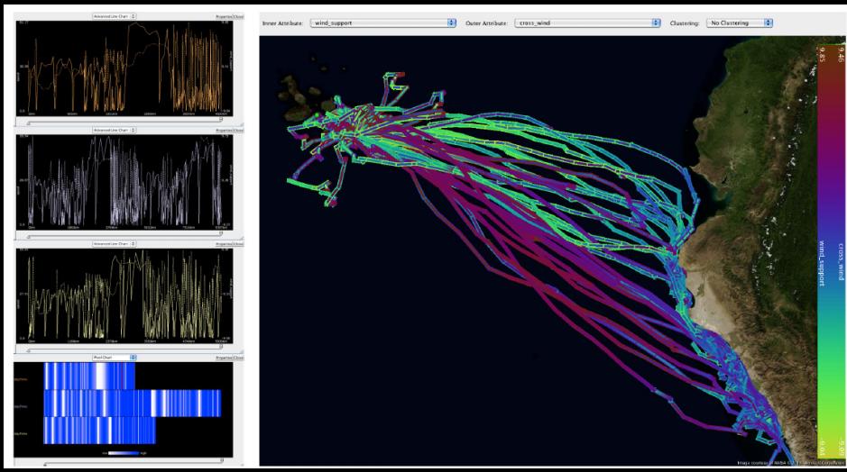
Notes:
Example #1: Bart and his moving animals Bart is a biologist and he studies animals. More precisely he wants to understand how animals move and how contextual factors influence their behavior. Think birds migrating from one place to another exploiting the right wind at the right moment or lions searching for a prey and trying to optimize their energy expenditure.
Problem is that animal movement analysis today is a very technological endeavor. Animals have GPS and other sensors attached and can be tracked continuously around the world and generate enormous amounts of data. Plus, this data can be enhanced with contextual factors like weather conditions, making the whole thing more difficult. How do you deal with that? Can you do it without visualization? The problem is that not only they want to test some hypotheses and assumptions they have, but they also want to be able to come up with new ideas.
Florian Mansmann (together with his valuable students) helps Bart and his colleagues understanding how these animals move, and developed a nice tool to visualize traces in time and to correlate them with contextual factors.

Slide 75
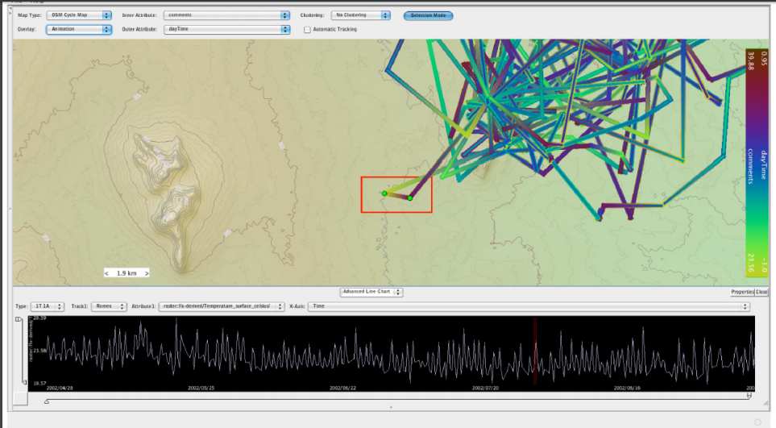
Notes:
My question is: do you think it is possible to do that without visualization? I think this is another case of indispensable visualization.

Slide 76
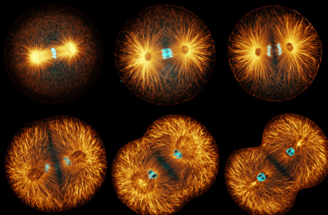
Notes:
Example #2: Joachim and his hidden molecules Joachim is a chemist at the University of Konstanz, where I work, and his job is to study small molecules that inhibit a fundamental process in cellular division called “cytokinesis”. I am not going to give any biology lesson here, I am totally inadequate, but it suffices to know that Joachim studies this stuff because it has implications on understanding cancer. Yes, cancer. Serious stuff.
Problem is that modern biology is done with computational tools and robots and he has to deal with tens of thousands of chemical reactions at once. He uses a technology called High-Throughput Screening by which a biological target can be tested with thousands of molecules in parallel in a matter of few hours. Isn’t it crazy?
But these data must be analyzed then and again there are no clear-cut preconceived hypotheses. Joachim has to delve through long excel spreadsheets and make sense of them. How primitive is this? And how indispensable is visualization here?

Slide 77
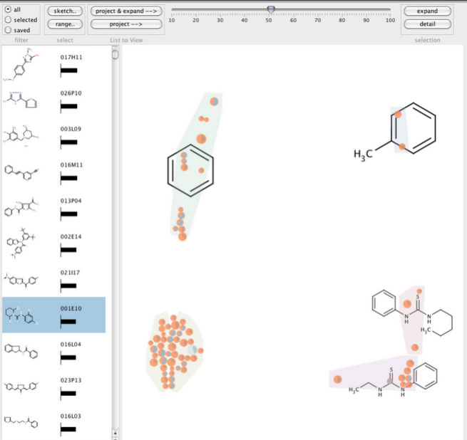
Notes:
So we developed a simple tool to let him explore the association between the activity level of these molecules (how much they react to the given target) and their molecular structure. Nothing too complicated from the visualization point of view: a very interactive and flexible scatter plot with well-designed mappings.

Slide 78
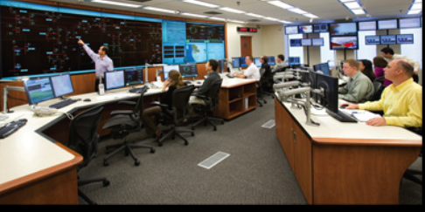
Notes:
Example #3: Security officers keeping us safe Even if we don’t notice it in our daily life, there are a number of people around us whose job is to monitor our infrastructures to keep us safe and to ensure that we have a steady delivery of fundamental services. We just started a new project here at the University of Konstanz to develop visual analytics tools to help this people monitor big amounts of information in real-time. These are for instance the guys who monitor the power grid infrastructure, a monster with millions of nodes spitting data 24hrs a day, and ensure that you can always recharge your PCs, switch your TV on, or heat up your food with your microwave. These guys do their job in control rooms like those depicted in this picture.

Slide 79
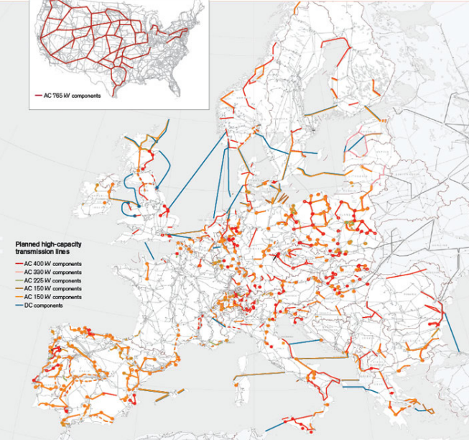
Notes:
Of course, this data monster is by no means tractable by visualization alone, data analysis and reduction algorithm, as well as complex simulations are needed, but do you think it is possible to do without visualization here? Do you have the feeling it is conceivable to make sense of what is going on there without visualization? I don’t think so.

Slide 80
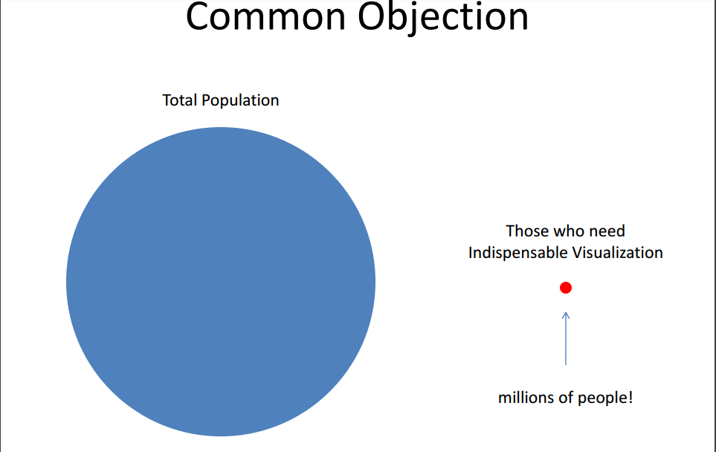
Notes:
But that’s a handful of highly skilled people!
A common objection I get when I explain this theory is something along these lines: “ok Enrico this is true, but how many people are in the condition of desperately needing interactive visualization up to the point it is indispensable? The people you describe here are a few very skilled knowledge workers which represent a tiny proportion of the overall population! Visualization has the power to affect a much much larger group”

Slide 81
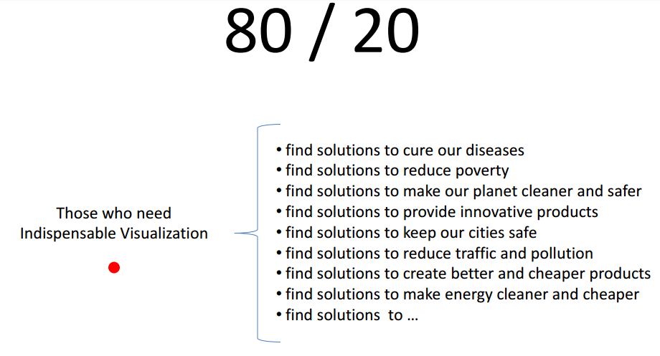
Notes:
I agree. It’s actually true that these are a few skilled workers if we reason in terms of proportions. Nonetheless, we have to realize two things:
The “tiny” proportion is millions of people. It’s not small! Jerome Cukier from OECD approached me after my talk and suggested: “You know what? I think you underestimated these numbers. There are 500 millions Excel users around the world!” Good point.
The “tiny” proportion are those who work to make our life better. There is a whole army of skilled professionals who study to:
find solutions to cure our diseases
find solutions to reduce poverty
find solutions to make our planet cleaner and safer
find solutions to provide innovative and pleasurable products
find solutions to keep our cities safe
… add another thousand rows
Shouldn’t we spend some time to help these people? I think we certainly have to. If we have the tools with the potential to expand their mind and do great things we have the responsibility to do it!

Slide 82
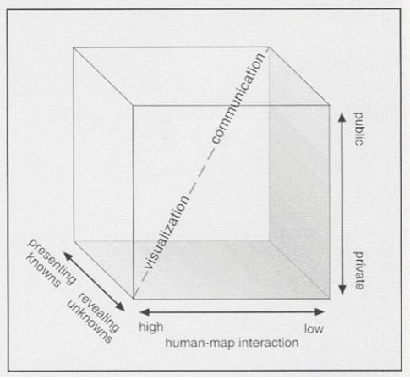
Alan M. MacEachran from “How Maps Work”
Notes:
Visualization use and the cartography cube
Finally, I think it’s necessary to reflect on how we are using visualization today, how we could use it in the future, and how this is related to indispensable visualization.
Fortunately, while thinking about the idea for this talk I stumbled upon a very useful diagram of visualization use. I found it in Alan MacEachren’s “How Maps Work” (by the way, this book is blowing my mind, it’s not at all only about maps and if you are very serious about visualization you should read it).
The model describes visualization use according to three main dimensions:
1) Private vs. Public: Is the visualization targeted to one person or a restricted group of people to solve a specific problem or it is more intended to address public audience?
2) Static vs. Interactive: Is the visualization a static representation or an interactive tool that people can use to explore alternative views?
3) Revealing Knowns vs. Revealing Unknowns: Is the goal to communicate a number of findings or messages to an audience or to provide people ways to explore the data and make sense of it?
My feeling is that visualization today, especially if seen under the lens of what the web and similar media offer to the average reader, is largely used as a communication tool, that is we are at the upper corned of the cube: largely public, mostly static or with little interaction, and mostly to reveal information that has been digested by someone else.
I call this use of visualization “visualization consumerism” (I hope nobody is offended by this name, it’s not my intent), that is, the visualization is prepackaged by someone in a format that can be easily and quickly digested by a large number of people. To be clear, I am not against it, as long as it is done well. Visualization is not only something to consume, we need to look at it in a different way.
What I propose is that we take more care of the knowledge workers I mentioned above and provide them with the indispensable tools they need. Visualization has the power to make us more intelligent and we should strive to do that.
And looking at the cube I think we have to shift our attention to the opposite corner of the cube if we want to help people make decisions.

Slide 83
Identify a Project:
Highly Interactive
Revealing Unknowns
Visualize Data

Slide 84
Summarize… 1. Start from the Question 2. Find a data source 3. Explore to understand the data 4. Identify the story 5. Think about how best to tell it 6. Build it. 7. Iterate for clarity.

Slide 85
Today’s Lesson: Visualization in Decision Making What makes Good Visualizations Distortion in Visualization Discussion Capstone Project Homework

Slide 86
VizWiz

Slide 87
Goal: Apply the principals from today to the data provided to create an interactive Epistemic visualization that helps viewers uncover unknown truths.

Slide 88
What is the judging criteria? Practicality / Relevance Easy to interpret. Answers a question. Storytelling A single, coherent story accurately representing the data. Innovative use of Tableau Visualization types, interactivity, and creativity. Design performance, beauty

Slide 89
Thank You

